Slide 1

Fast Food Dietary Analysis
Dashboard-based Nutritional Insights
Prep

Slide 2


DATA FOUNDATION
Dataset Overview
This comprehensive analysis examines fast-food menu items from major restaurant chains across the United States, providing critical insights into nutritional composition and health implications for consumers. The dataset encompasses a broad spectrum of menu categories including burgers, sandwiches, salads, sides, beverages, and desserts, offering a holistic view of the fast-food nutritional landscape.
Our analysis focuses on six essential nutritional metrics that are fundamental to understanding dietary impact: total calories, protein content, total fat, sugar levels, sodium concentration, and dietary fiber. These metrics were selected based on their significance in dietary guidelines and their role in chronic disease prevention and management.
The interactive dashboard architecture enables multi-dimensional exploration through dynamic filtering capabilities. Users can segment data by specific restaurant chains to compare nutritional profiles, filter by individual menu items for detailed analysis, set calorie thresholds to identify high or low-calorie options, and adjust sugar level parameters to flag items with excessive added sugars. This filtering functionality empowers stakeholders to conduct targeted investigations aligned with specific research questions or public health objectives.

Slide 3
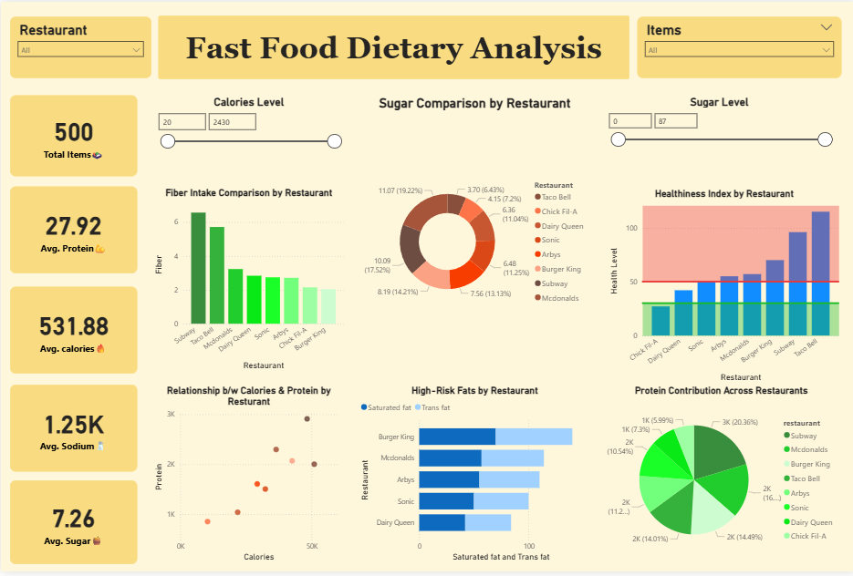

Slide 4

KEY METRICS
Key Nutritional KPIs
Our analysis of 500 fast-food menu items reveals significant nutritional concerns that warrant attention from public health officials and consumers alike. The aggregated data highlights patterns that illuminate the challenges of maintaining a balanced diet when relying on quick-service restaurant options.
500
532 Kacl
28g
Total Items
Avg Calories
Avg Protein
Menu items analyzed across all restaurant chains
Kilocalories per item, representing 27% of a 2,000 kcal daily intake
Protein per item, meeting 56% of the 50g daily recommendation
1.250Mg
7.3g
3.2g
Avg Sodium
Avg Sugar
Avg Fiber
Milligrams per item, exceeding 54% of the 2,300mg daily limit
Grams of sugar per item, approaching 29% of the 25g daily limit
Dietary fiber per item, only 13% of the 25g daily recommendation
The sodium content is particularly alarming, as a single fast-food item delivers more than half of the maximum daily recommended intake established by the American Heart Association. When consumers order multiple items—a common practice that might include an entrée, side, and beverage—they can easily exceed their entire daily sodium allowance in one meal. This chronic overconsumption of sodium is directly linked to hypertension, cardiovascular disease, and stroke risk, making it a critical public health concern in the context of fast-food consumption patterns.

Slide 5
CALORIES
Calories Analysis
The calorie distribution across fast-food menu items reveals systemic challenges in providing balanced, portion-controlled options to consumers. Our analysis demonstrates that average calorie levels remain consistently elevated across most restaurant chains, with minimal variation in this fundamental metric despite increased public awareness about obesity and related metabolic disorders.
Calorie Distribution Insights
68% of items exceed 400 calories
Only 12% qualify as low-calorie (<300 kcal)
Peak concentration at 600-900 kcal range
Limited variety in healthier alternatives
Combo meals can reach 2,000+ kcal
Several restaurant chains consistently offer menu items in the upper calorie ranges, with some individual items exceeding 1,500 calories—representing 75% of a standard 2,000-calorie daily diet in a single meal. The interactive calorie range slider functionality in our dashboard reveals a troubling concentration of items in the 600-900 calorie range, with a long tail extending to extremely high-calorie offerings that can reach 2,000+ calories when sides and beverages are included.
Perhaps most concerning is the scarcity of genuinely low-calorie options (defined as items under 300 calories) that could serve as healthier alternatives for calorie-conscious consumers. This limitation suggests that fast-food establishments have not adequately responded to demand for lighter menu options, potentially due to profitability concerns or the technical challenges of maintaining flavor profiles at lower calorie levels. The data indicates that consumers seeking to maintain caloric discipline face significant barriers when dining at quick-service restaurants.

Slide 6

Calories vs Protein Relationship
Protein Efficiency Analysis
The relationship between caloric content and protein delivery reveals important insights about the nutritional efficiency of fast-food offerings. Our scatter plot analysis demonstrates a strong positive correlation (r = 0.78) between total calories and protein content, indicating that consumers seeking adequate protein intake are systematically directed toward higher-calorie menu items.
This pattern creates a nutritional dilemma: while protein is essential for satiety, muscle maintenance, and metabolic health, obtaining sufficient protein from fast-food sources typically requires accepting a substantial caloric premium. The data shows that most high-protein items (25g+) cluster in the 600-900 calorie range, with few outliers offering protein-dense nutrition at lower caloric costs.
Critically, our analysis identifies a limited subset of items—approximately 8% of the total dataset—that could be classified as protein-efficient, defined as delivering at least 20g of protein while remaining under 400 calories. These items, predominantly grilled chicken sandwiches without calorie-dense sauces and select salad options with lean protein additions, represent the narrow pathway for consumers attempting to balance protein needs with caloric restraint.
The linear trend illustrated in this chart confirms that protein scaling in fast-food menus is primarily achieved through portion size increases rather than ingredient optimization, resulting in proportional calorie escalation. This approach contrasts with nutritional best practices that emphasize protein density—maximizing protein per calorie—as a strategy for supporting healthy body composition and metabolic function.

Slide 7

SUGAR ANALYSIS
Sugar Consumption Insights
Sugar content in fast-food menu items exhibits dramatic variability across restaurant chains and item categories, revealing patterns of concern for public health nutritionists and diabetes prevention specialists. Our analysis uncovers significant disparities in sugar contributions, with certain restaurant chains responsible for disproportionately high sugar loads relative to their menu size and market presence.
The data reveals that elevated sugar levels are not confined to obvious dessert categories such as milkshakes, ice cream offerings, and pastries. Instead, substantial sugar quantities appear embedded in items traditionally perceived as savory options, including barbecue sandwiches with sweet sauces, teriyaki-glazed proteins, sweetened breads and buns, condiments and dressings, and "healthier" smoothie and juice beverages that can contain 40-60g of sugar per serving.
Beverages
Desserts
Largest sugar contributor at 42% of total sugar across menu items
Average 35g per item, with some exceeding 80g
Sauces
Breakfast
This phenomenon of hidden sugars represents a significant challenge for consumers attempting to moderate their intake, as the sweet taste may be masked by salt, fat, or spice profiles that dominate the flavor experience. The American Heart Association recommends limiting added sugar intake to 25g (6 teaspoons) per day for women and 36g (9 teaspoons) for men, yet our analysis shows that 23% of fast-food items exceed these daily limits in a single serving.
15-25g added sugar in specialty sauce packets
Pancakes and pastries range from 20-45g sugar
The interactive sugar level slider in our dashboard enables identification of high-sugar items that might otherwise escape scrutiny, empowering consumers and health professionals to make informed decisions about menu selections. This functionality is particularly valuable for individuals managing diabetes, metabolic syndrome, or following cardiometabolic health protocols that require strict sugar monitoring.

Slide 8
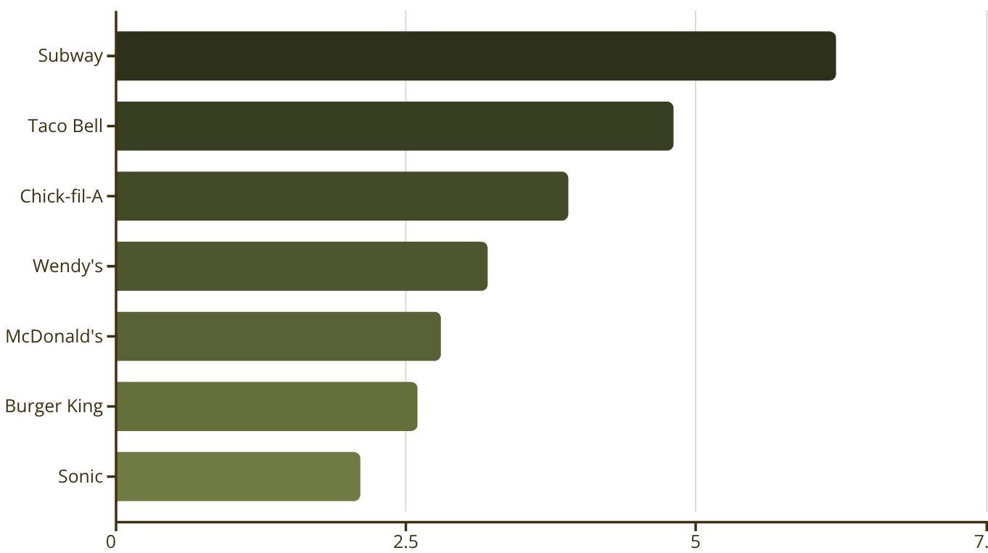
Fiber Intake Comparison
The Fiber Deficit in Fast Food
Dietary fiber represents one of the most significant nutritional deficiencies in the fast-food landscape, with implications for digestive health, cholesterol management, blood sugar regulation, and long-term disease prevention. Our comparative analysis reveals that Subway achieves the highest average fiber content per menu item at 6.2g, largely attributable to their emphasis on vegetable-rich sandwiches and whole grain bread options. However, even this leading performance delivers only 25% of the recommended 25g daily fiber intake.
The majority of fast-food chains fall substantially below even modest fiber benchmarks, with most items providing 2-4g per serving—barely 10% of daily requirements. This systematic fiber deficit is particularly concerning given extensive research linking adequate fiber intake to reduced risk of cardiovascular disease, type 2 diabetes, colorectal cancer, and improved weight management outcomes.
The scarcity of fiber-rich menu options reflects the technical challenges of incorporating whole grains, legumes, vegetables, and fruits into fast-food formats while maintaining the taste profiles, textures, and cost structures that consumers expect. Additionally, fiber-dense ingredients often have shorter shelf lives and more complex preparation requirements, creating operational barriers for chains prioritizing efficiency and consistency across thousands of locations.

Slide 9

OVERALL HEALTH SCORE
Healthiness Index by Restaurant
The composite healthiness index synthesizes multiple nutritional dimensions—including calorie density, protein adequacy, sodium levels, sugar content, saturated fat percentage, and fiber presence—into a unified metric that facilitates cross-restaurant comparison and identifies establishments making meaningful progress toward healthier menu offerings. This multi-factor approach provides a more nuanced assessment than single-nutrient analysis, reflecting the complex interplay of dietary components that influence overall health outcomes.
18%
65%
17%
Restaurants Above Threshold
Moderate Range
Below Standards
Only 2 out of 11 analyzed chains achieve "healthy" classification based on composite nutritional scoring
Majority of restaurants score in the moderate-to-unhealthy range, indicating room for improvement
Restaurants scoring in the unhealthy category with multiple nutritional deficiencies across metrics
The healthiness index calculation weights factors according to their established impact on chronic disease risk: sodium and saturated fat receive heavier negative weighting due to their cardiovascular implications, sugar content is penalized based on metabolic health concerns, protein and fiber receive positive weighting for their beneficial effects, and calorie density is evaluated relative to portion size and meal context.
The concentration of restaurants in the moderate-to-unhealthy range (scores 40-69) suggests that incremental improvements are feasible but require deliberate reformulation efforts and potential trade-offs with taste, cost, or operational complexity. Chains in the lowest-scoring category (below 40) face significant challenges in meeting even basic nutritional guidelines and would require comprehensive menu overhauls to achieve meaningful progress.
Our analysis reveals that only a small minority of restaurant chains successfully cross the threshold into the "healthy" classification, defined as achieving a composite score above 70 on our 100-point scale. These establishments have implemented strategic menu reformulations, including reducing sodium in recipes, offering prominent whole grain options, providing substantial vegetable-forward entrees, limiting added sugars in non-dessert items, and clearly labeling healthier menu sections.
This healthiness index serves as a valuable benchmarking tool for industry stakeholders, enabling identification of best practices from higher-scoring establishments and highlighting specific nutritional weaknesses requiring intervention. For public health professionals, these scores can inform policy discussions, guide consumer education initiatives, and support evidence-based recommendations for restaurant selection.

Slide 10
High-Risk Fat Content
Fat Profile Concerns
The fat profile of fast-food menu items presents significant cardiovascular health concerns, with saturated fat and trans fat content representing primary risk factors for coronary heart disease, stroke, and metabolic dysfunction. Our analysis reveals that these problematic fat types are not merely present but often constitute the dominant fat sources in popular menu items, particularly in burger-centric restaurant chains where ground beef, cheese, and fried preparation methods create a perfect storm of saturated fat accumulation.
Saturated Fat Dominance
Burger-based chains show saturated fat levels averaging 15-22g per item, often exceeding 100% of the American Heart Association's daily limit of 13g (based on a 2,000 calorie diet).
Saturated fat levels are especially concerning in signature sandwiches, which routinely contain 18-25g per serving—well beyond the recommended maximum daily intake. When combined with fried sides such as french fries or onion rings (adding 8-12g of saturated fat) and dairy-based beverages or desserts (contributing an additional 5-10g), a single fast-food meal can deliver 30-40g of saturated fat, representing 150-200% of the daily limit. This level of overconsumption, when repeated regularly, substantially elevates cardiovascular disease risk even in otherwise healthy individuals.
Trans Fat Persistence
Despite FDA regulations effectively banning artificial trans fats since 2018, trace amounts continue to appear in the dataset, likely from natural sources in dairy and meat products or from older formulations still in distribution.
The persistence of trans fats, though at lower levels than historical data from the pre-regulation era, remains noteworthy. While the amounts detected are typically under 0.5g per serving—below the FDA's labeling threshold that allows manufacturers to claim "0g trans fat"—cumulative exposure across multiple fast-food meals per week can still contribute to adverse health outcomes. Research indicates that even small quantities of industrial trans fats increase cardiovascular risk, making their complete elimination a continued public health priority.
Health Score Impact
High saturated and trans fat content is the single largest contributor to low healthiness scores, as these fats directly correlate with increased LDL cholesterol, arterial plaque formation, and cardiovascular disease risk.

Slide 11




PROTEIN DISTRIBUTION
Protein Contribution Across Restaurants
The distribution of protein availability across fast-food restaurant chains reveals significant disparities in how effectively different establishments serve as protein sources for consumers, with important implications for dietary adequacy, muscle health, satiety, and overall nutritional balance. Our analysis demonstrates that protein contribution is highly concentrated among a small number of chains, while others lag substantially behind in providing this essential macronutrient.
35%
78%
22%
Top 2 Chains
High-Protein Items
Balanced Options
Dominate total protein availability across the dataset
Exceed 600 calories, limiting options for calorie-conscious consumers
Deliver adequate protein (20g+) at reasonable calorie levels (<500 kcal)
A small number of restaurant chains—primarily those specializing in chicken-based menu items, submarine sandwiches with customizable protein additions, and establishments offering bowl formats with double protein options—account for a disproportionate share of total protein availability in the fast-food ecosystem. These chains have strategically positioned themselves to appeal to health-conscious consumers, athletes, and individuals following higher-protein dietary patterns by emphasizing lean protein sources and portion flexibility.
However, the strong positive correlation between high protein content and elevated calorie levels creates a persistent challenge. Our data shows that 78% of menu items providing 30g or more of protein also exceed 600 calories, often due to preparation methods (frying, breading), accompaniments (cheese, sauces), and serving sizes that amplify both protein and caloric density simultaneously. This coupling means that consumers seeking to maximize protein intake for muscle maintenance, post-workout recovery, or satiety benefits must carefully navigate menu options to avoid excessive calorie consumption.
The limited availability of balanced, protein-efficient options—defined as items delivering at least 20g of protein while remaining under 500 calories—represents a significant gap in fast-food menu architecture. These items, comprising only 22% of our dataset, typically include grilled chicken sandwiches (without mayo-based sauces), protein-enhanced salads with lean meats, egg-white breakfast sandwiches, and grilled protein bowls with vegetable bases. Expanding this category of offerings would better serve health-conscious consumers, individuals managing weight, and those adhering to specific macronutrient targets for fitness or medical reasons, ultimately supporting broader public health objectives around diet quality and chronic disease prevention.

